Slide 1
Project Update - 20/07/2020
This week’s activity:
Draft writing, improvements made to introduction, and draft abstract.
Moved work to local notebook, vast improvement in working efficiency
Reading papers regarding suggestions made in previous meeting, discrete vs. continuous approaches
Initial data augmentation for white noise and sliced background noise

Slide 2
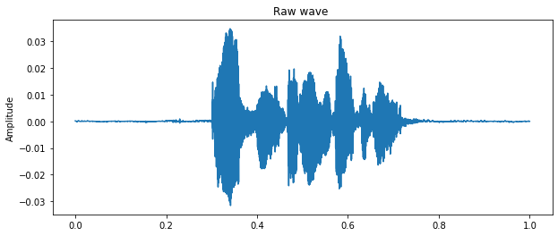
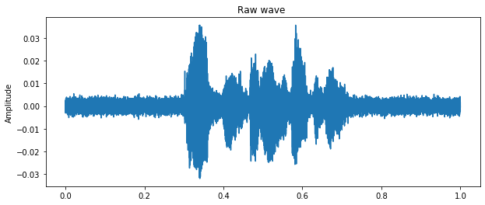
Data Augmentation
Should reduce generalisation of model, important in studies regarding speech recognition. This is part of the project which should be done regardless of other changes in direction and is therefore useful at this stage. As it is desired to emulate real world sources, initially implemented SNR augment (white noise).
This new dataset is exported to .wav and has features extracted as with clean datasets.

Slide 3
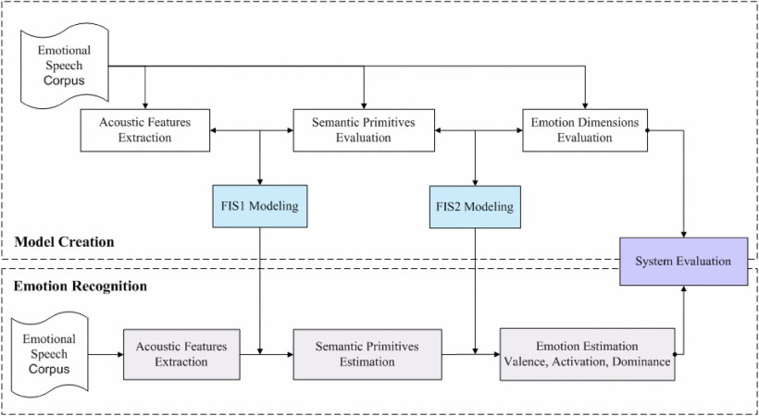
Discretization of data
Current area of active research regarding project approach
Using these findings regarding dimensional approach, debate the following:
Opportunity to use continuous values via probability of binary classification
Avoid complexities of numerical labelling of data
Importance of classification accuracy vs. intensity to the given context of this study*
Clarification on these points to be made this week to allow further progress to writing.

Slide 4
Questions for this week
Utilising labelled data for use with continuous values, discretization of classifier data discussion *
E.g. percentage of probability being specific class to provide intensity of emotion
Query regarding review of writing, clarity of abstract and introduction

